Slide 1

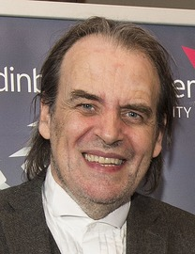
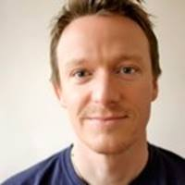
Professor Bill Buchanan OBE. Research into cryptography, blockchain and identity. Leads with Blockpass ID Lab.
Twitter: @billatnapier Web: asecuritysite.com
Rich Macfarlane. Associate Professor. Research into ransomware, crypto, and malware. Supports ENUSEC and is the Programme Leader for MSc in Advanced Security and Digital Forensics.
Twitter: @rjmacfarlane

Slide 2
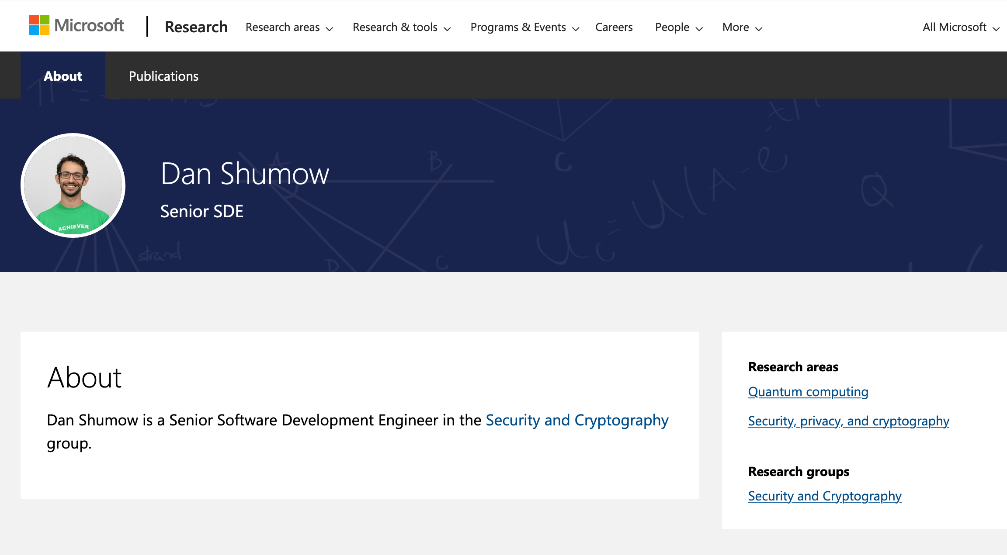

Slide 3
Syllabus
No | Date | Subject | Lab
2 | 17 Sept 2020 | 1. Introduction [Link] 2. Intrusion Detection Systems [Link] | Introduction to Vyatta Lab
3 | 24 Sept 2020 | 3. Network Security [Link] | Vyatta and Snort.
4 | 1 Oct 2020 | 4. Ciphers and Fundamentals [Link] | pfSense.
5 | 8 Oct 2020 | 5. Secret Key 6. Hashing [Link] | Vulnerability Analysis and IDS
6 | 15 Oct 2020 | 7. Public Key [Link] 8. Key Exchange [Link] | Public/Private Key and Hashing
7 | 22 Oct 2020 | 9. Digital Certificates
8 | 29 Oct 2020 | Study | Study
9 | 5 Nov 2020 | Test 1 details | Test 1 [Link]
10 | 12 Nov 2020 | 10. Network Forensics [Link] | Network Forensics
11 | 19 Nov 2020 | 11. Tunnelling [Link] | Tunnelling
12 | 26 Nov 2020 | 12. Splunk | Splunk Lab
13 | 3 Dec 2020 | 13. Blockchain and Cryptocurrencies [Link] | Blockchain Lab
14 | 10 Dec 2020 | Test 2 details (TBC)
15 | 17 Dec 2020 | Hand-in: TBC [Here]

Slide 4
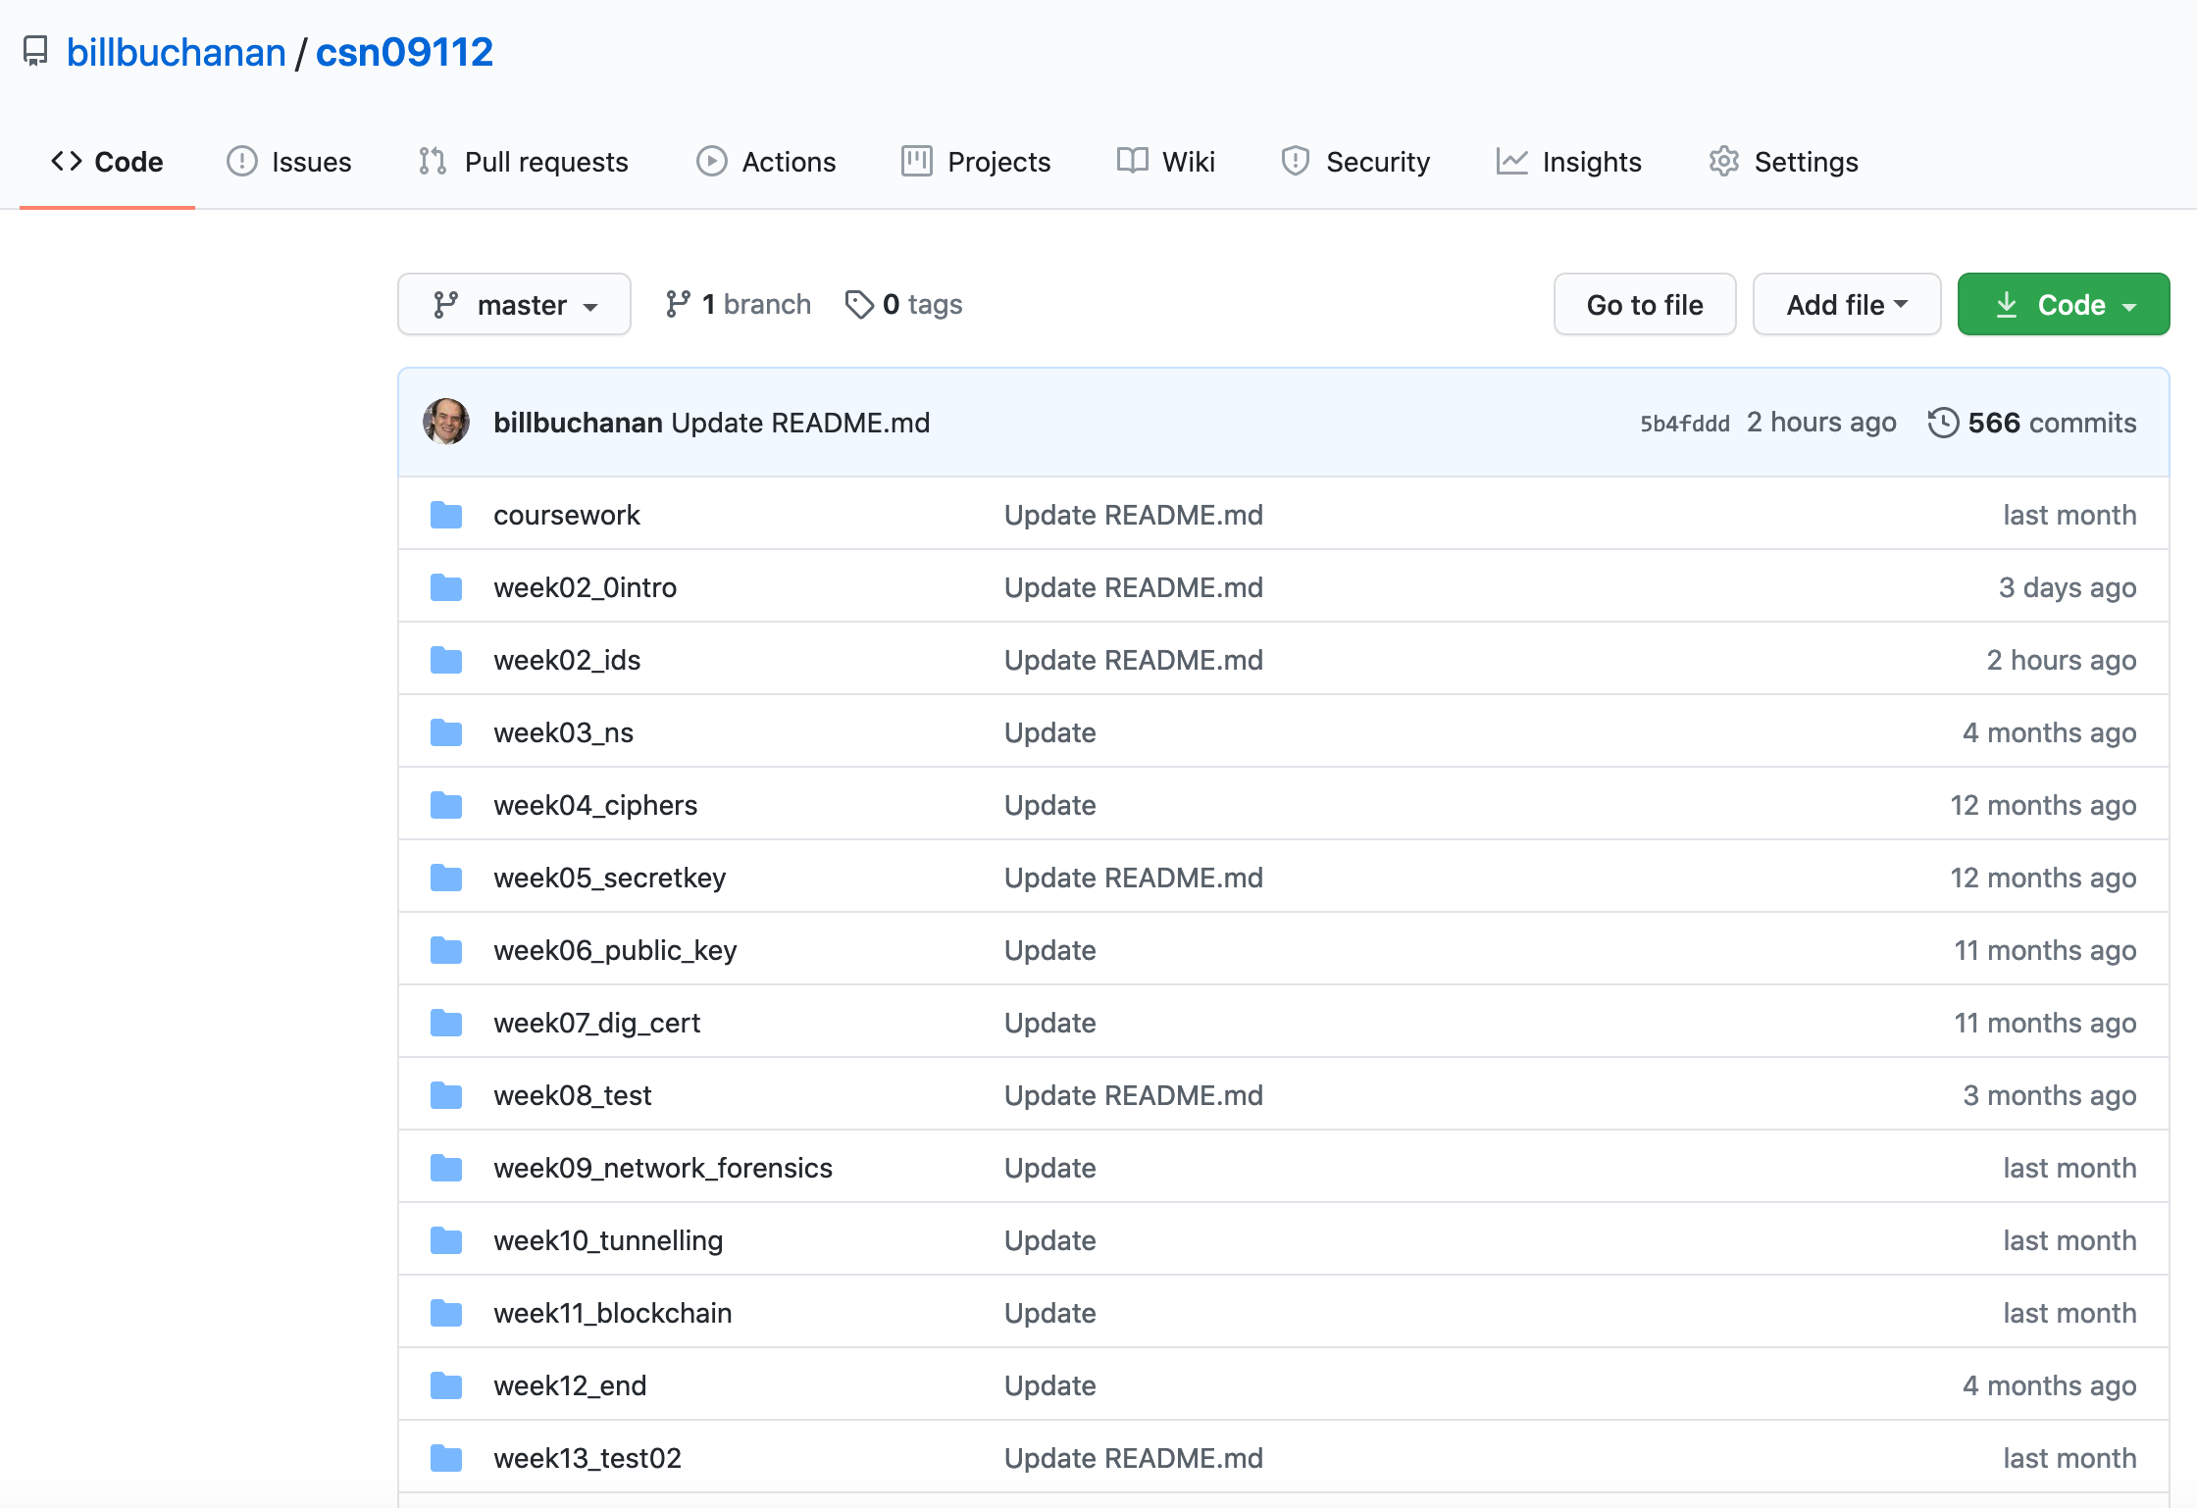
Content
git clone https://github.com/billbuchanan/csn09112

Slide 5
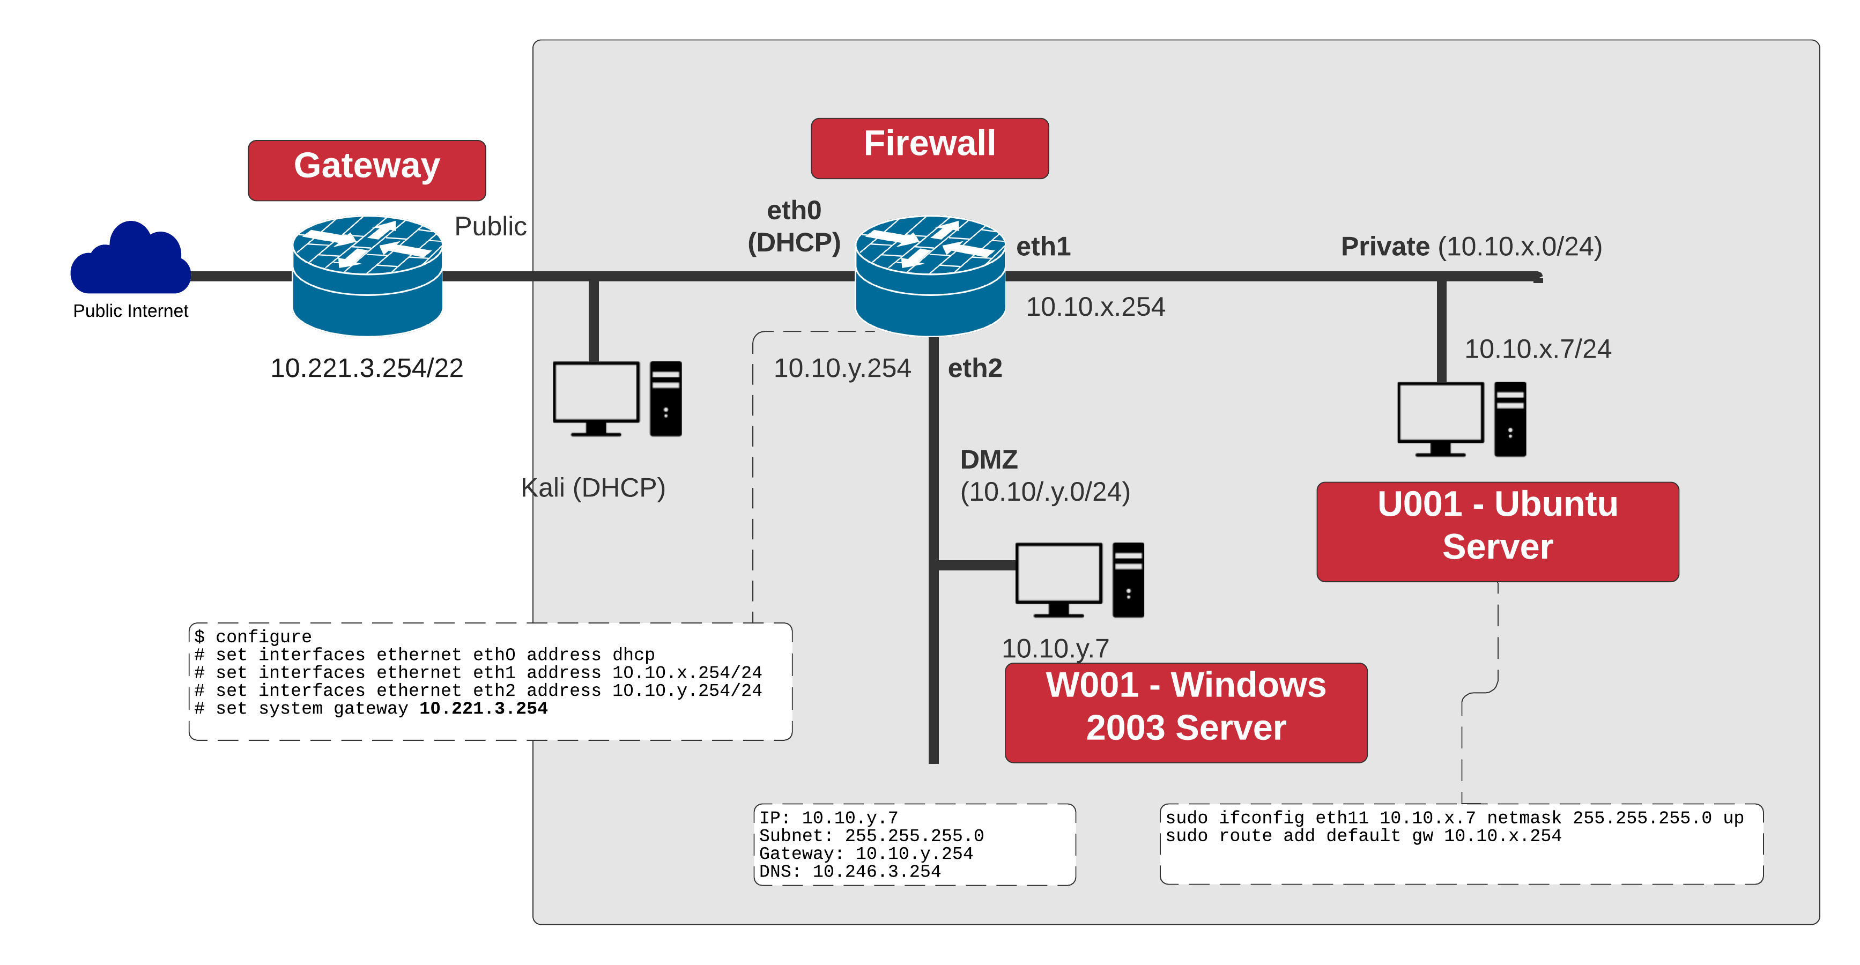
Lab Environment

Slide 6
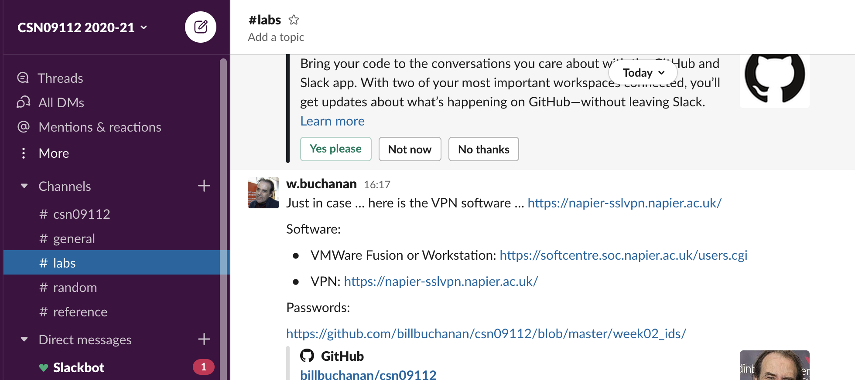
Slack
csn0911220202021.slack.com

Slide 15
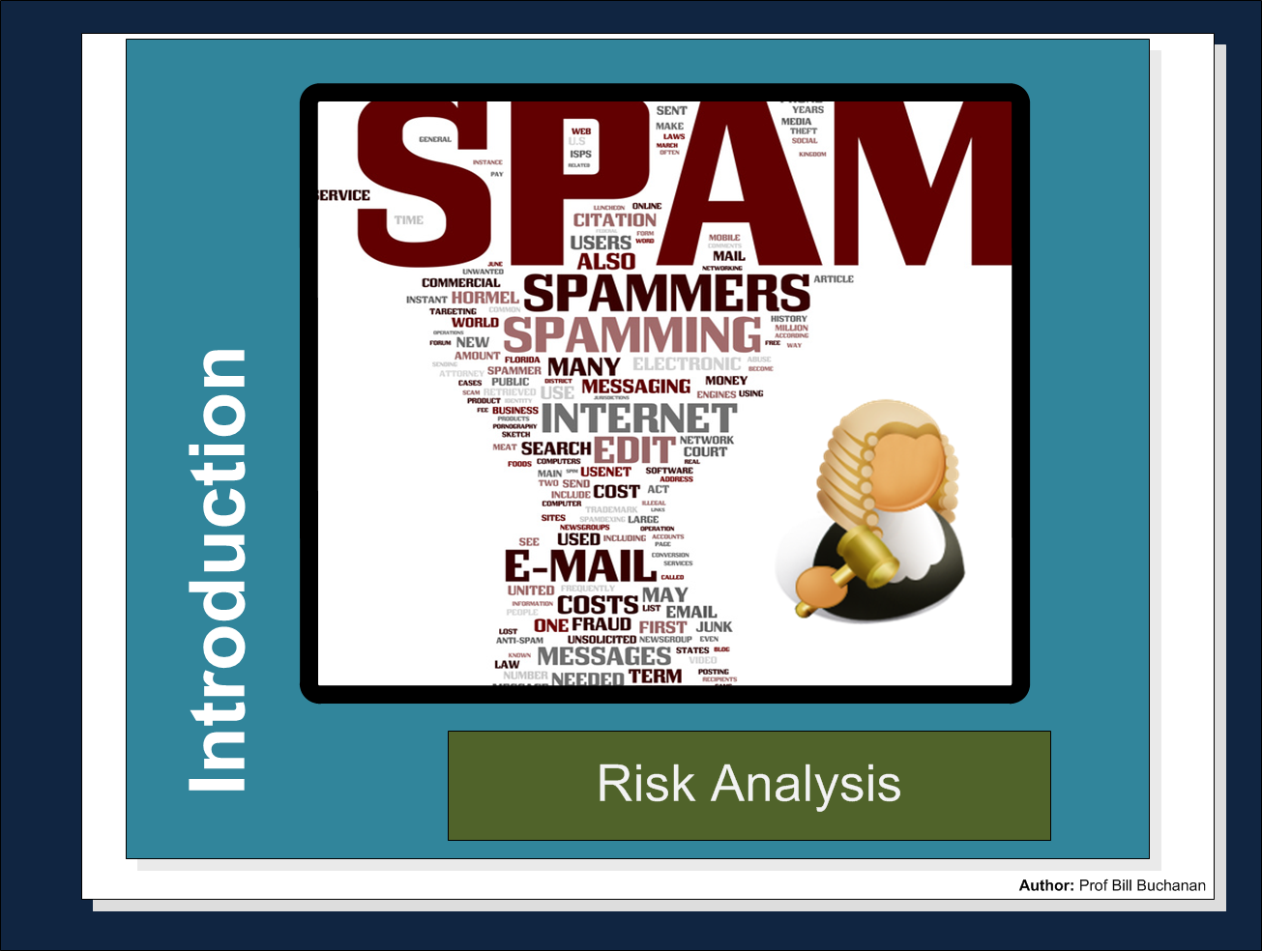

Slide 16
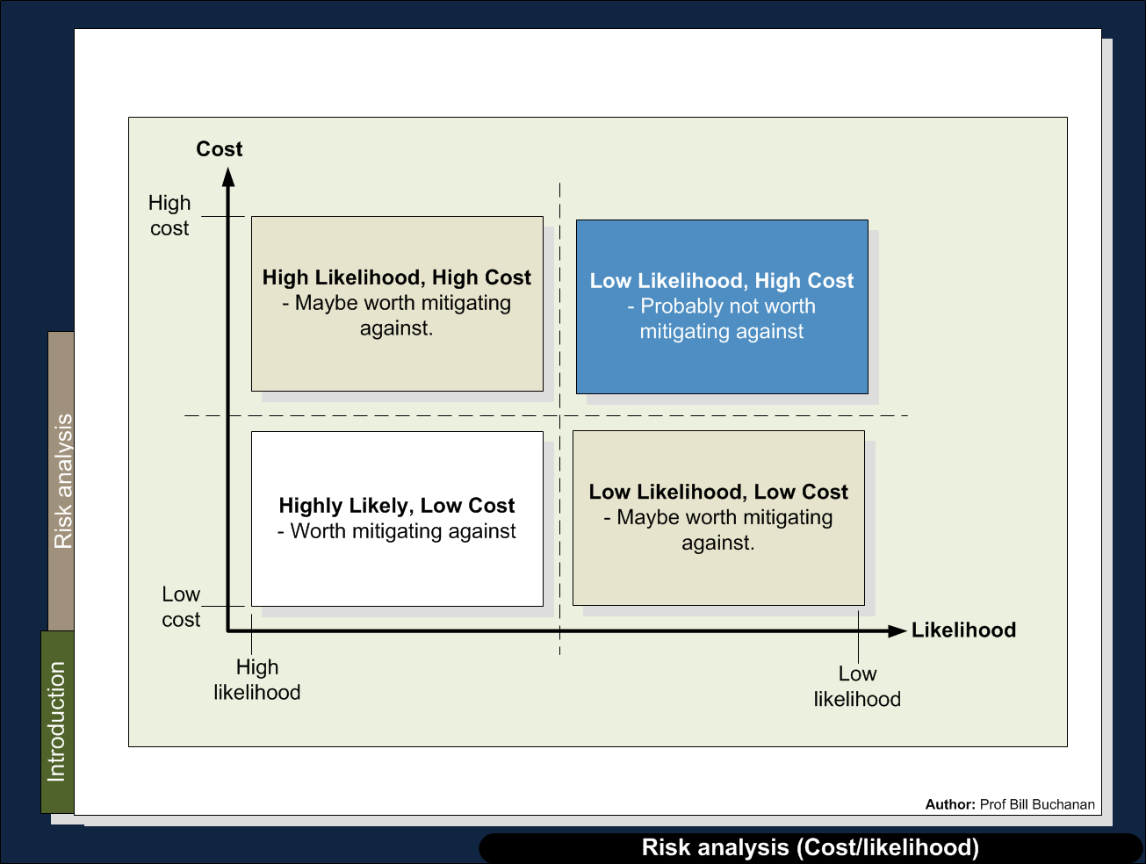

Slide 17
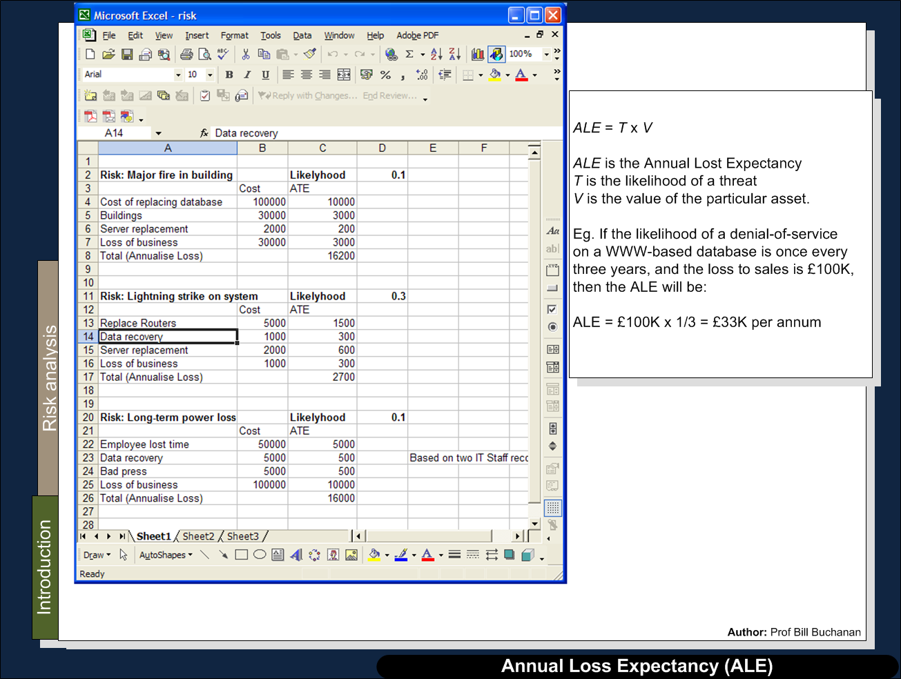

Slide 18
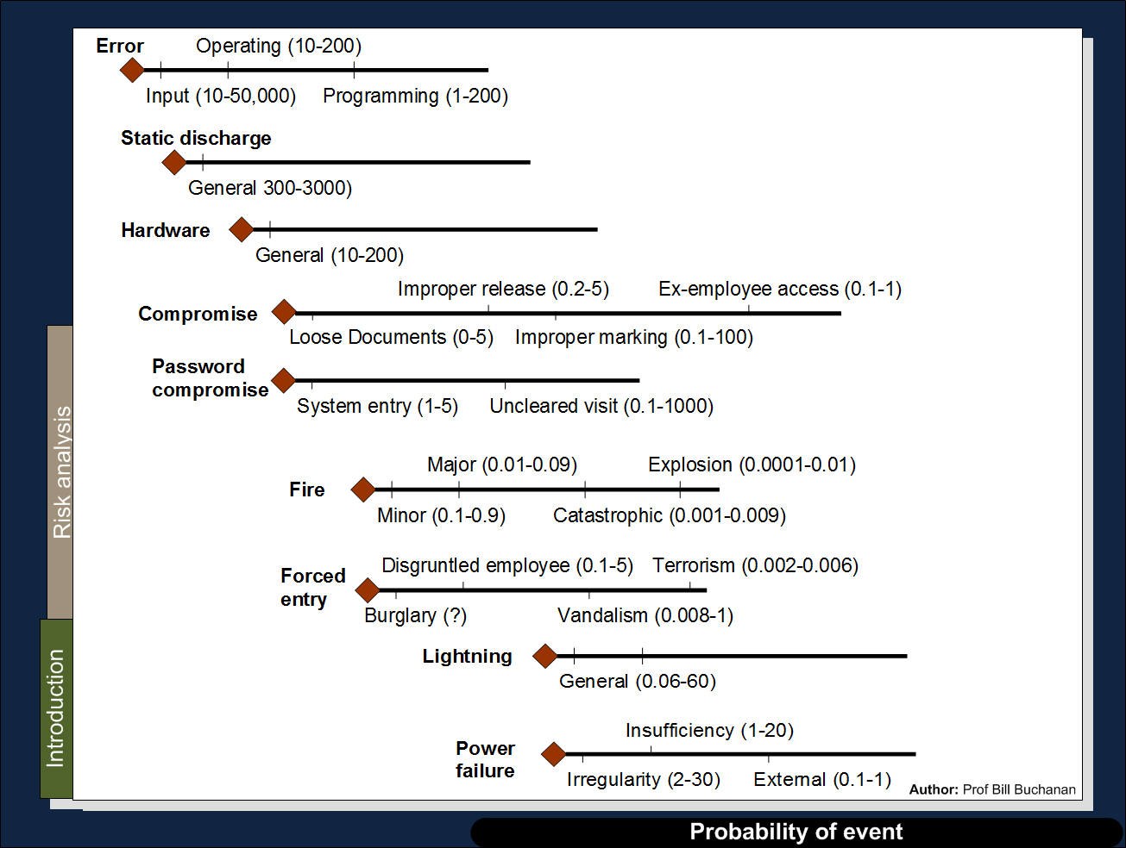

Slide 19
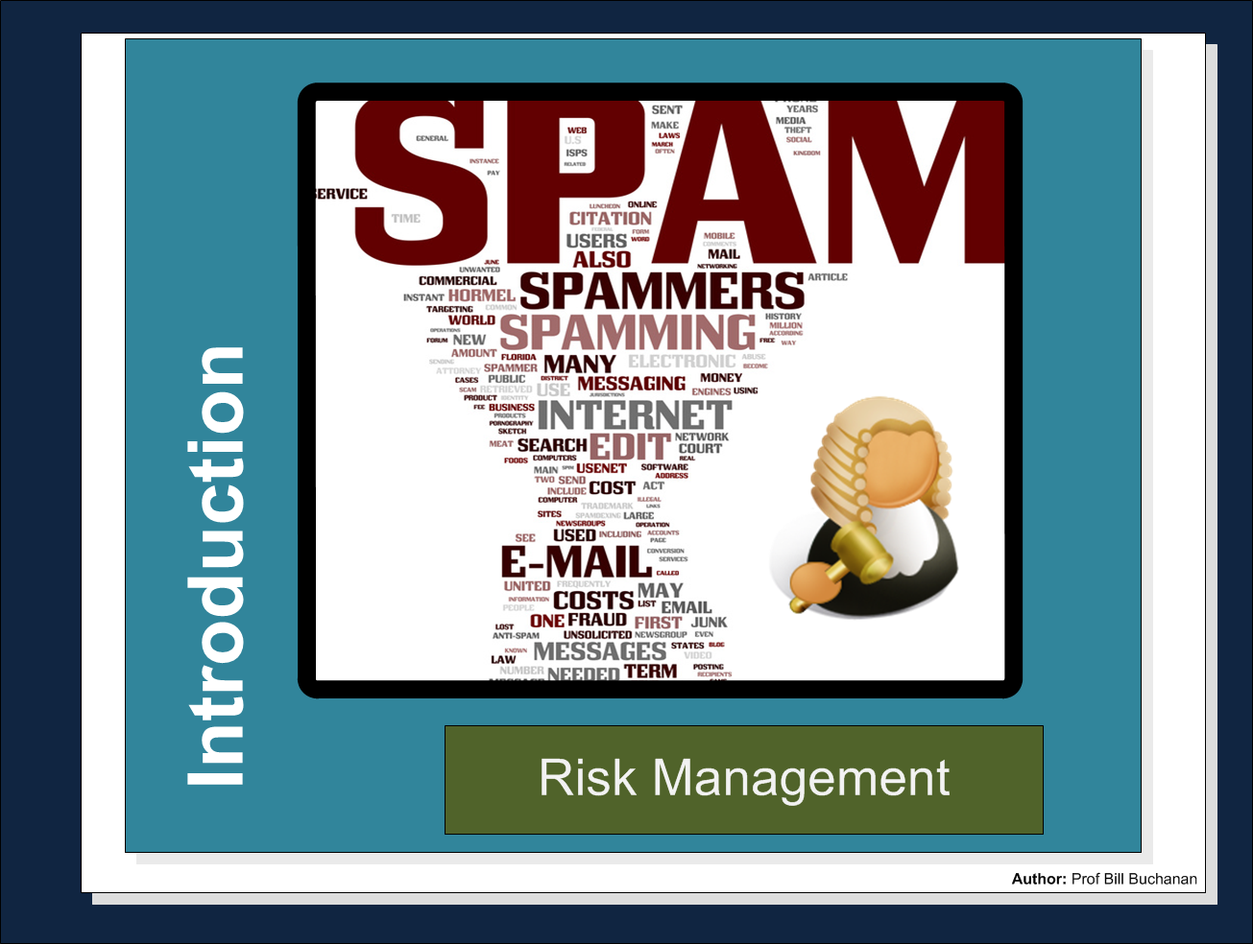

Slide 20
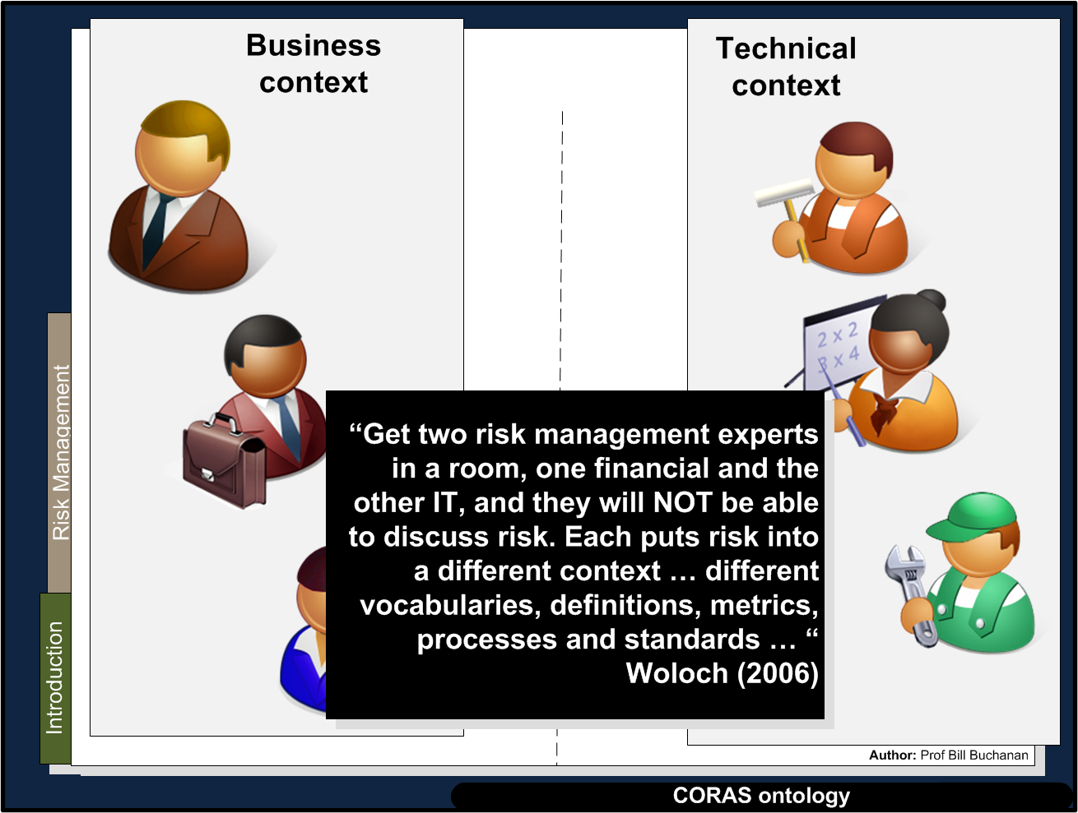

Slide 21
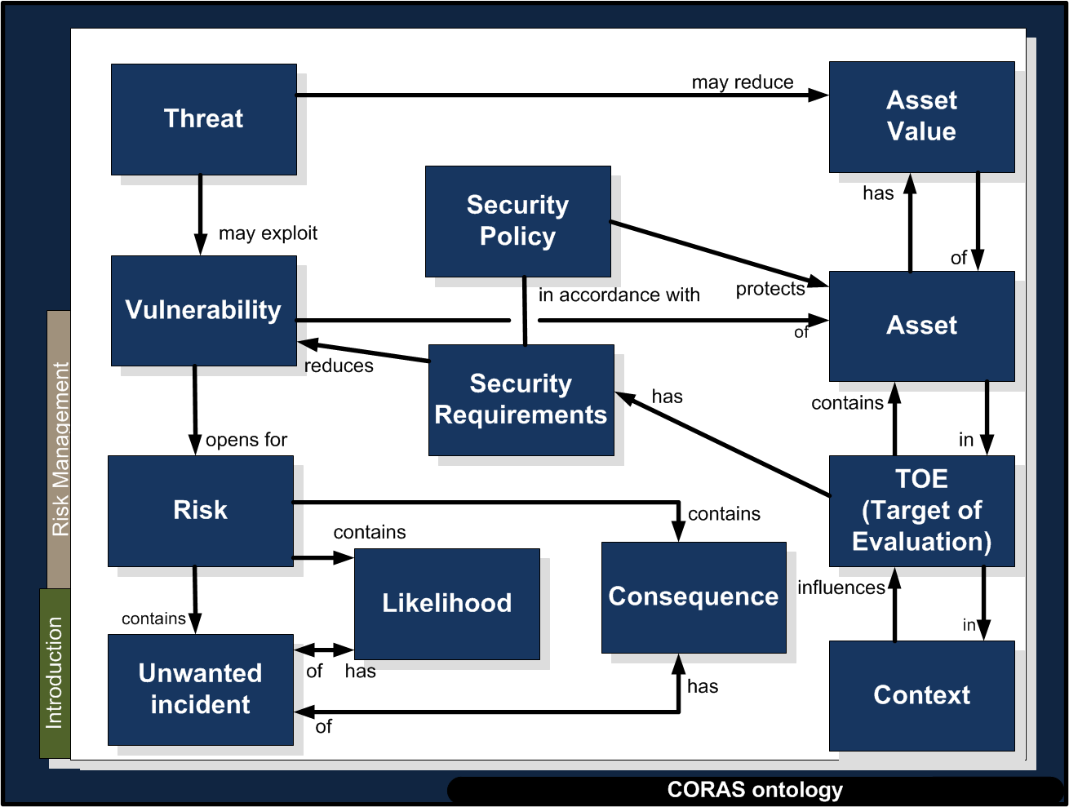

Slide 22
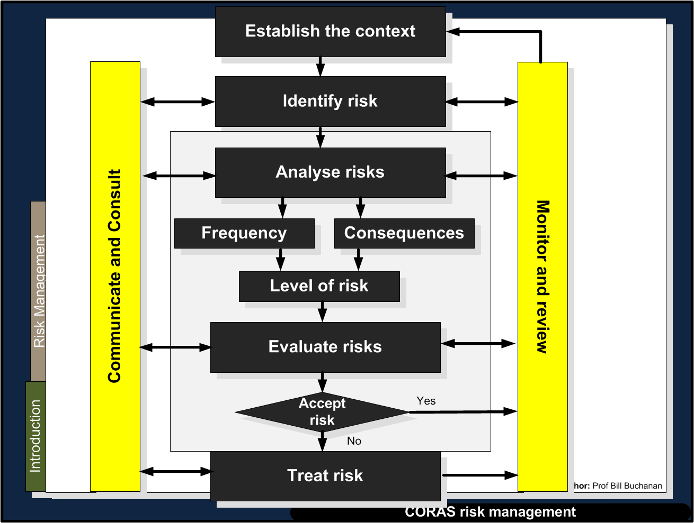

Slide 23
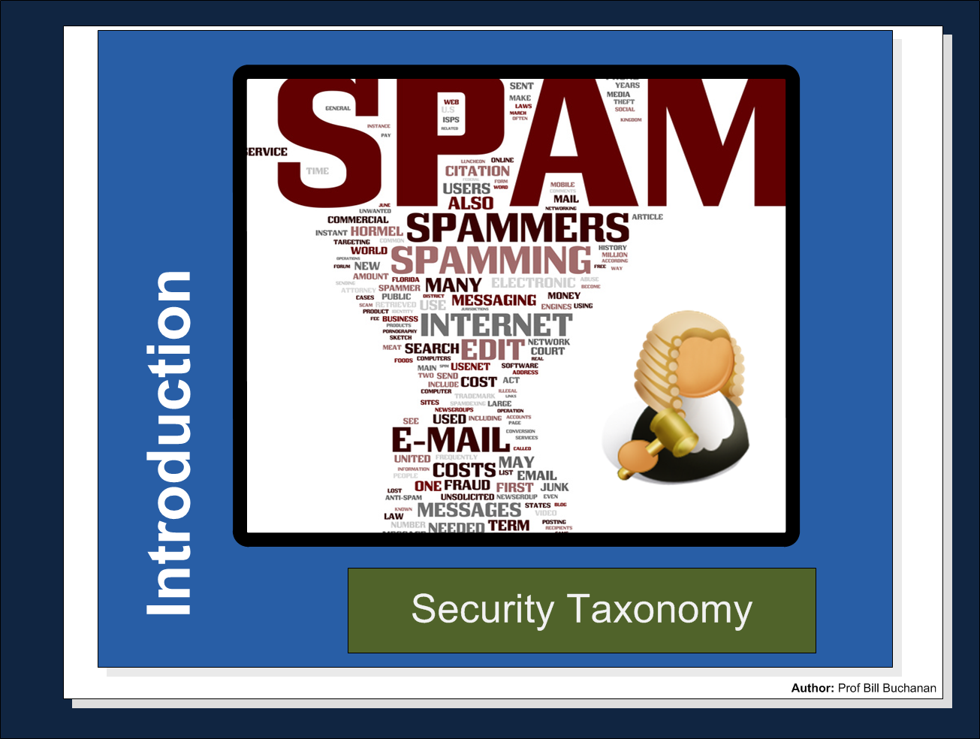

Slide 24
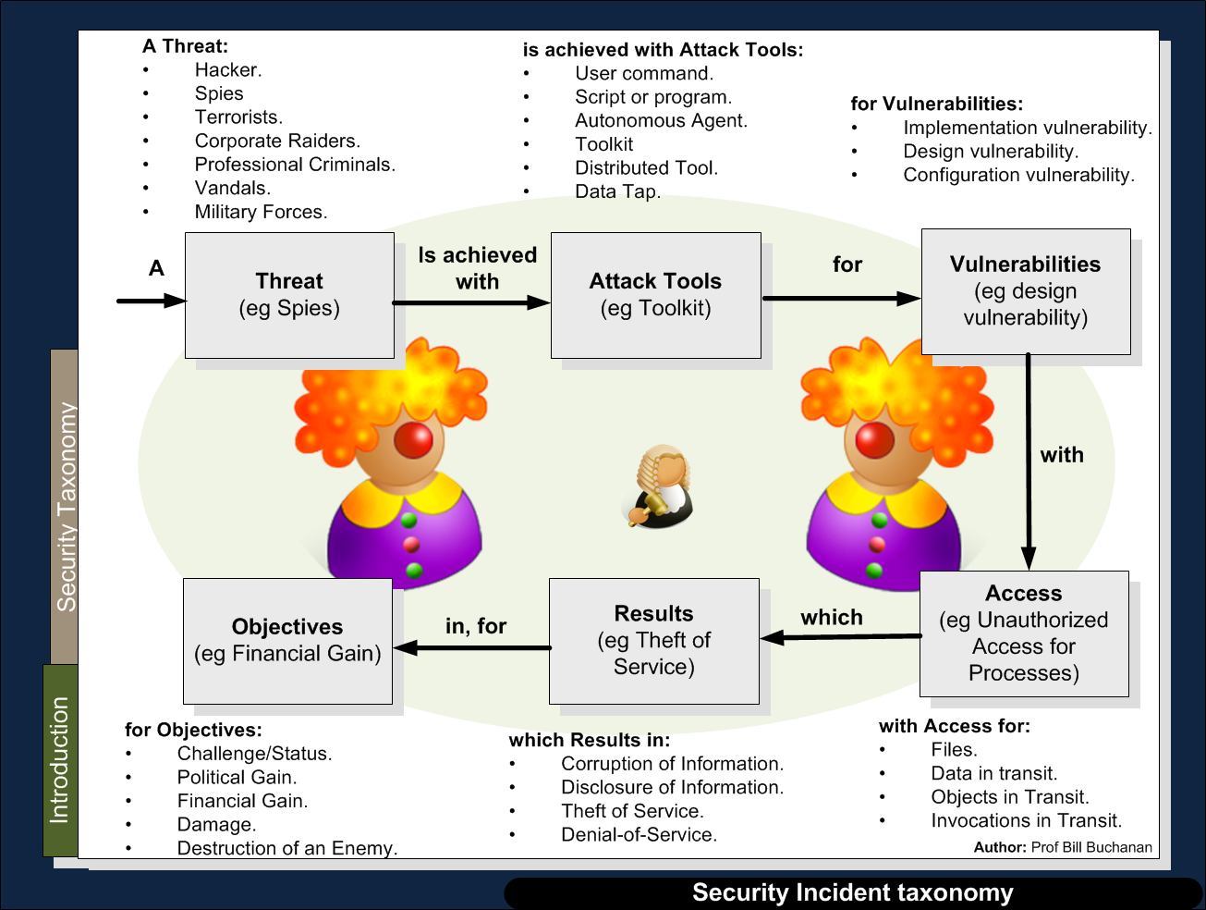

Slide 25
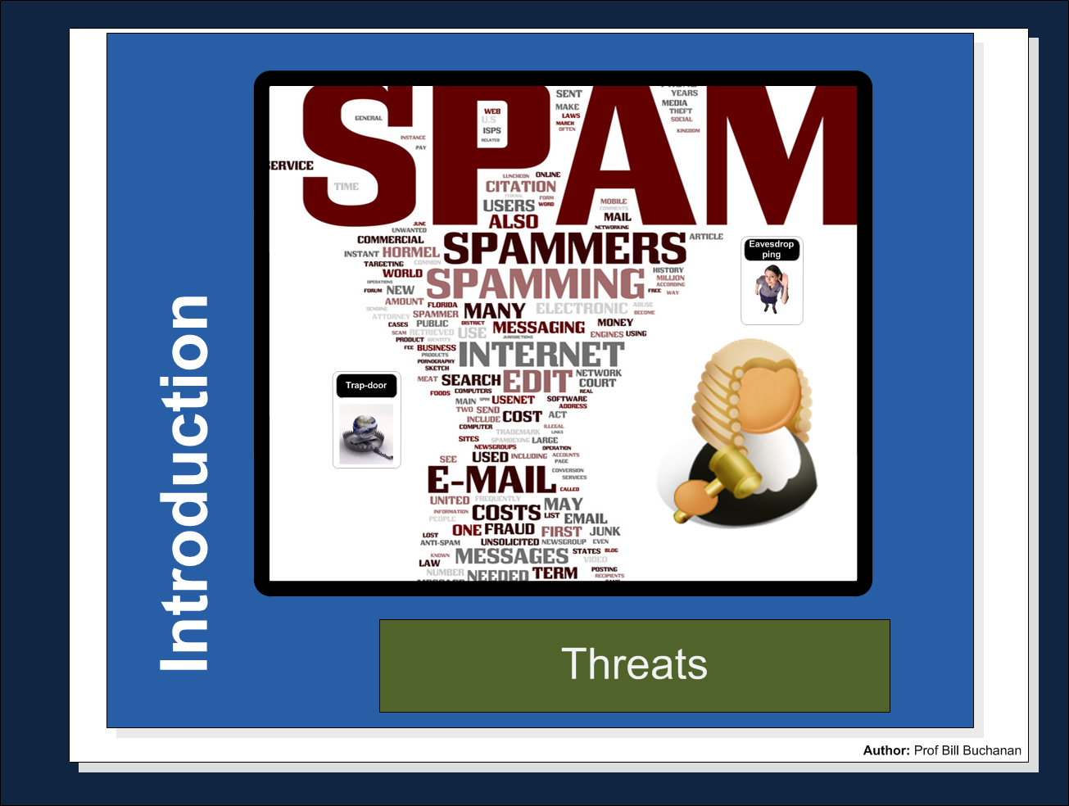

Slide 26
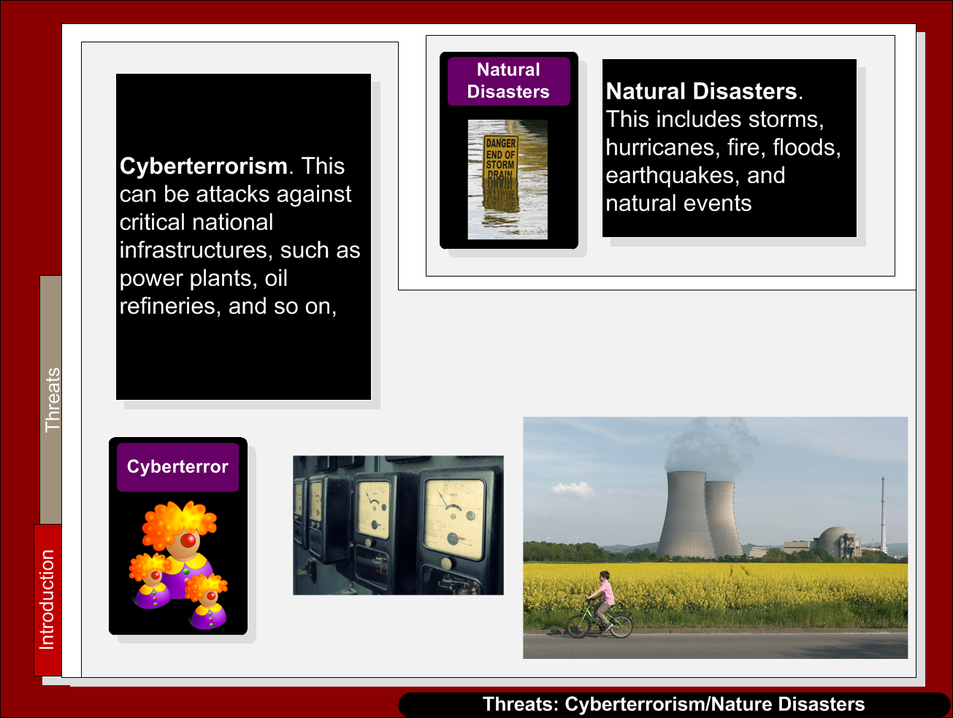

Slide 27
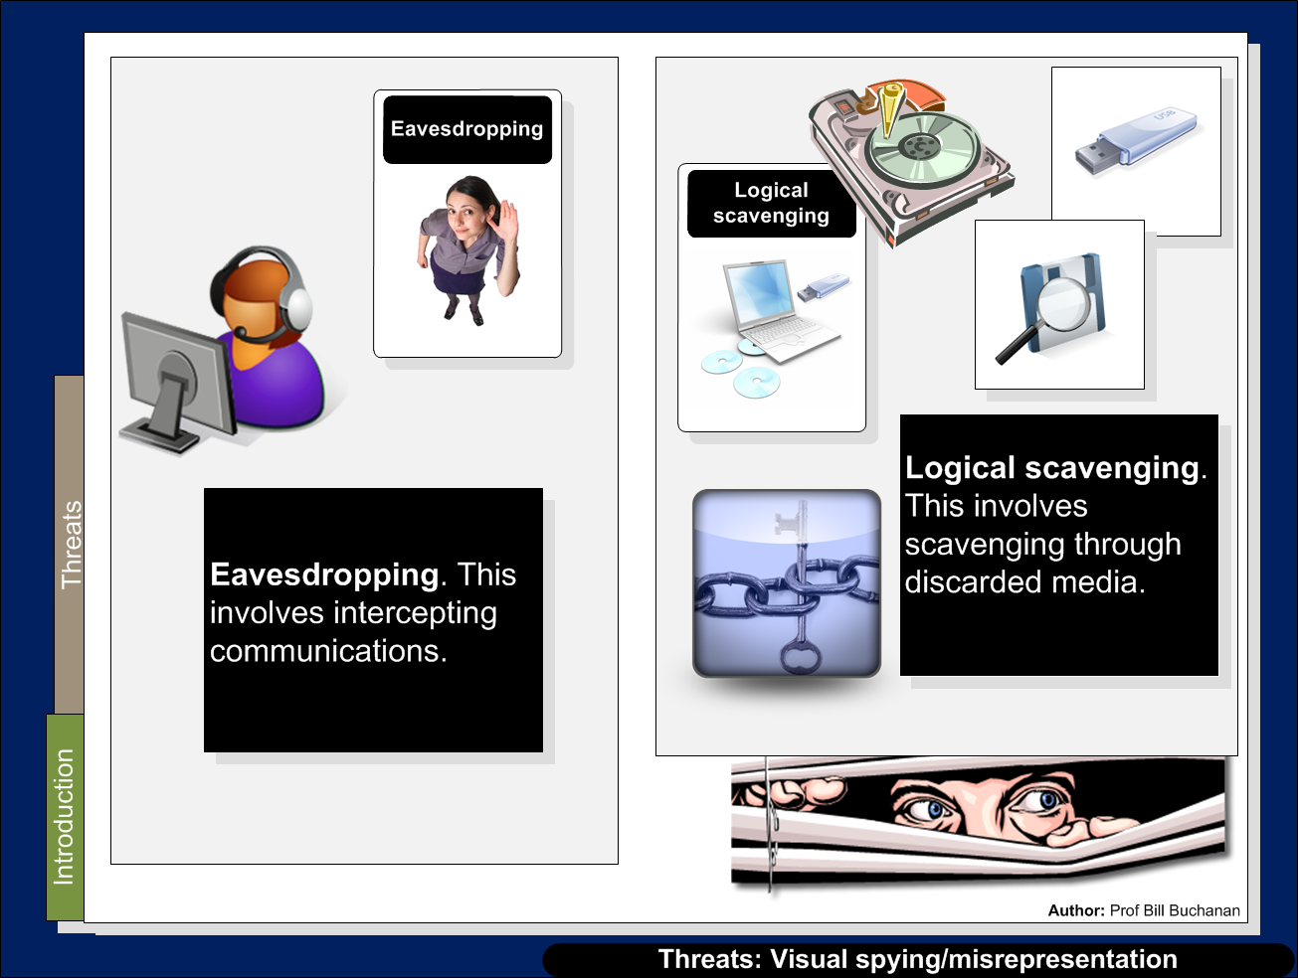

Slide 28
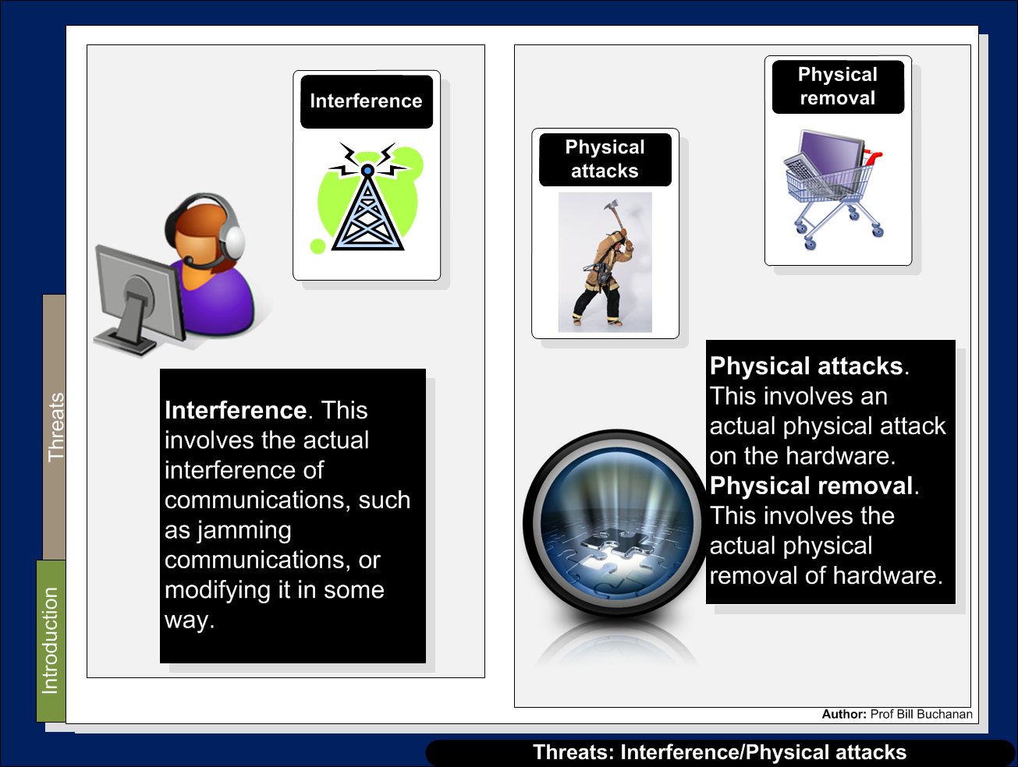

Slide 29
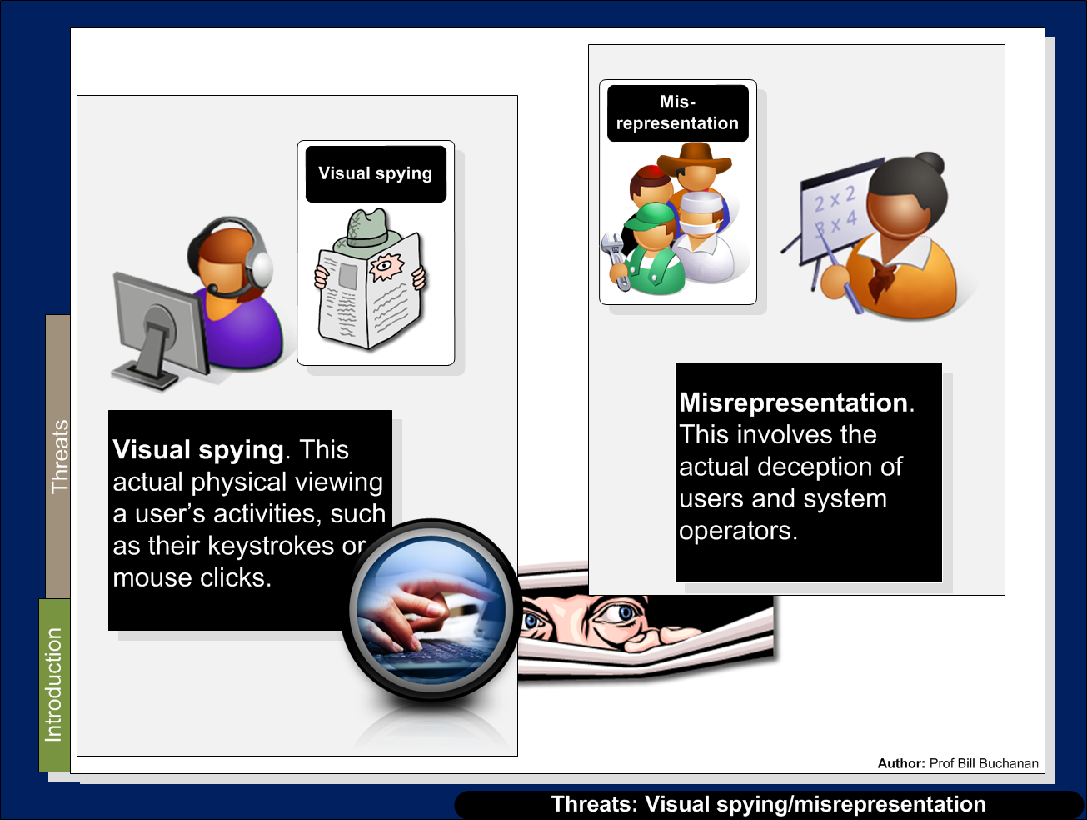

Slide 30
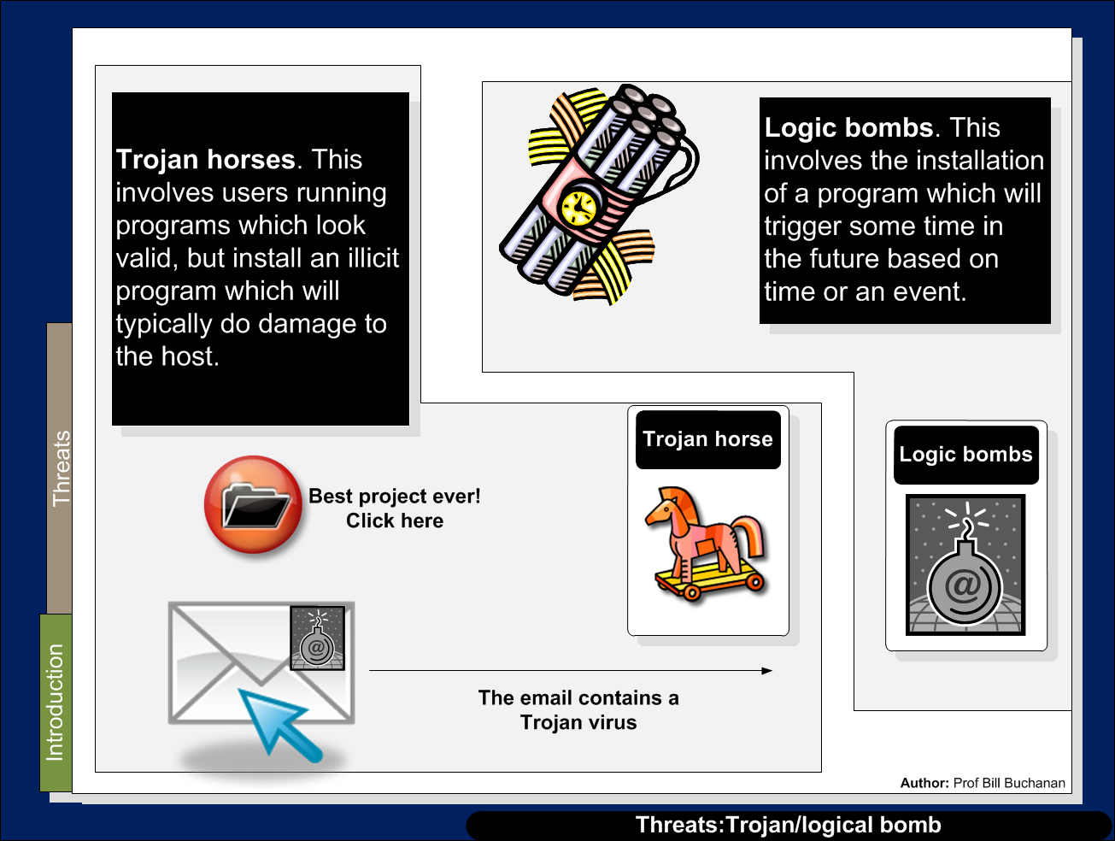

Slide 31
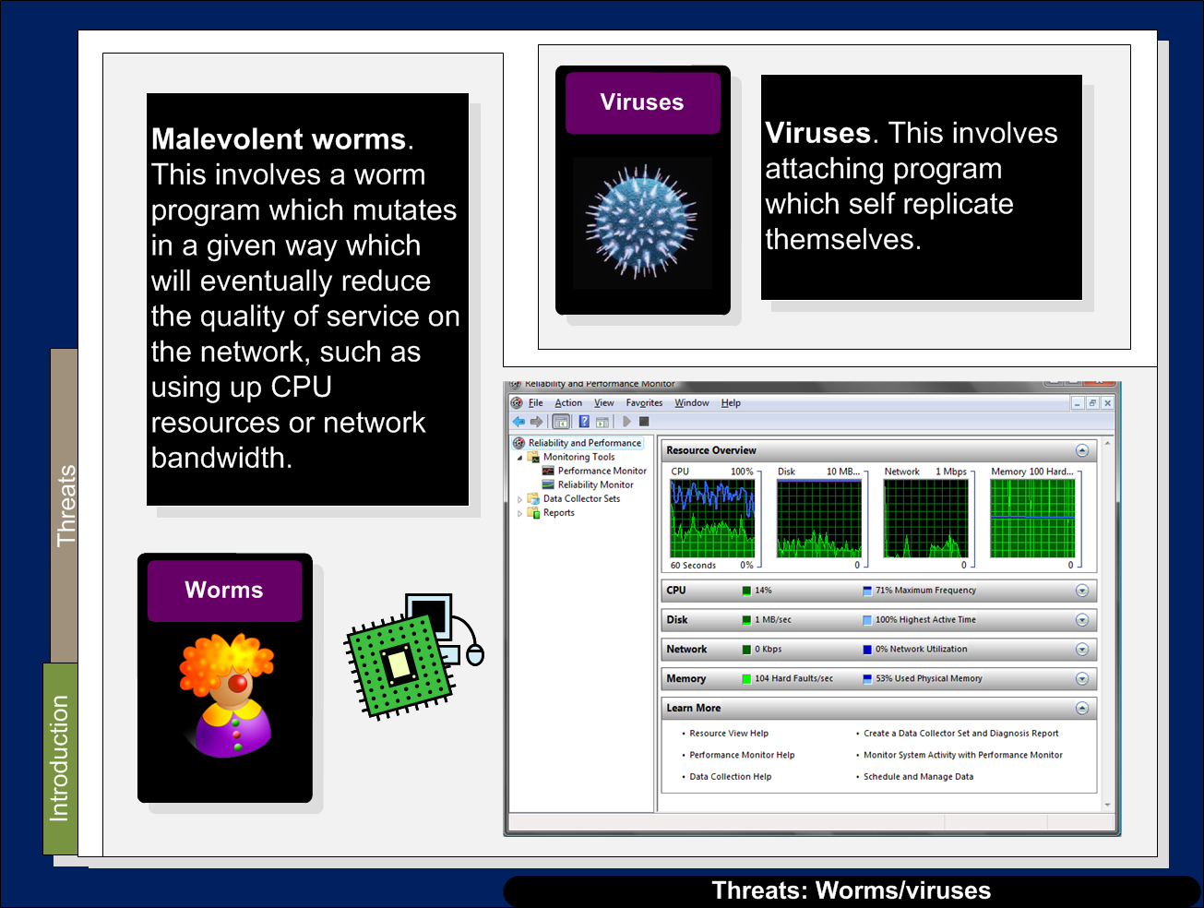

Slide 32
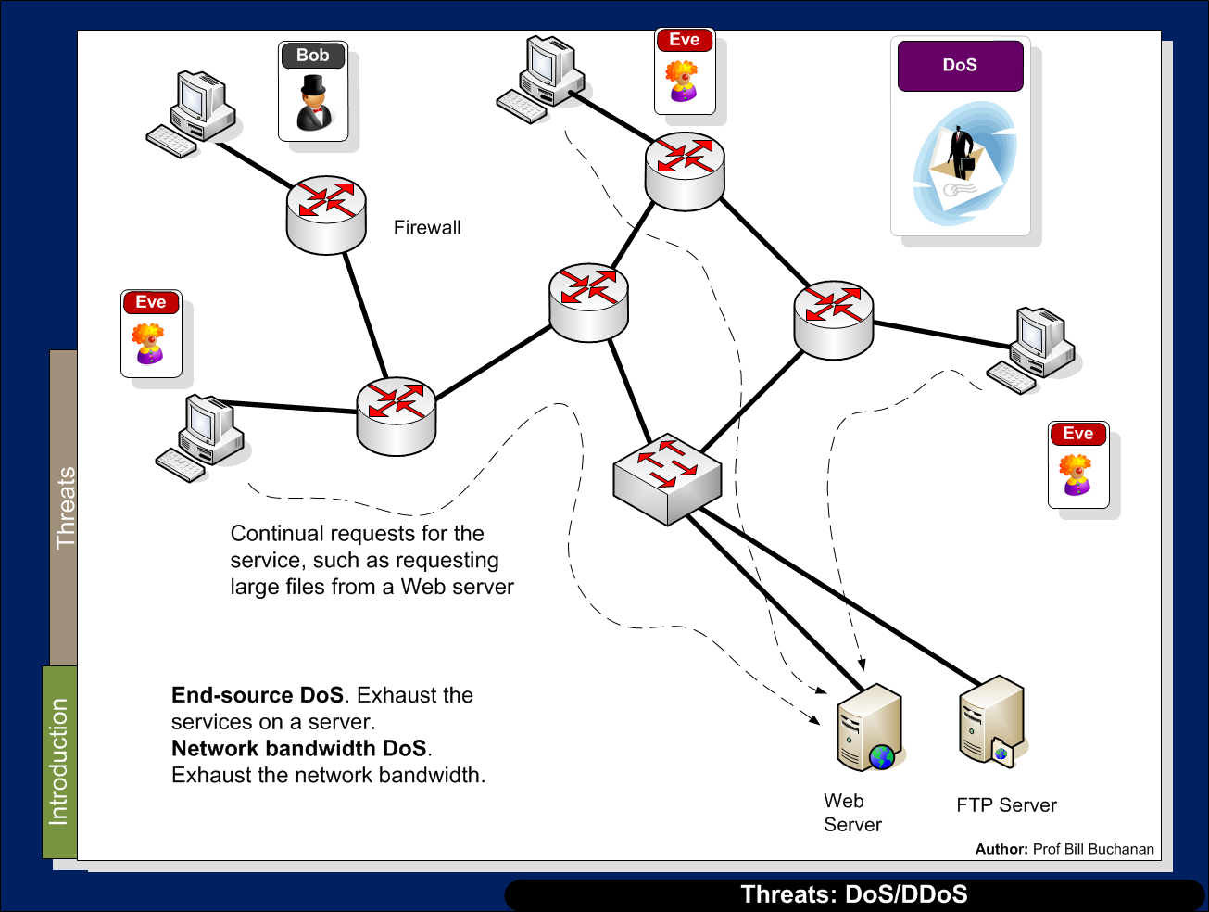

Slide 33
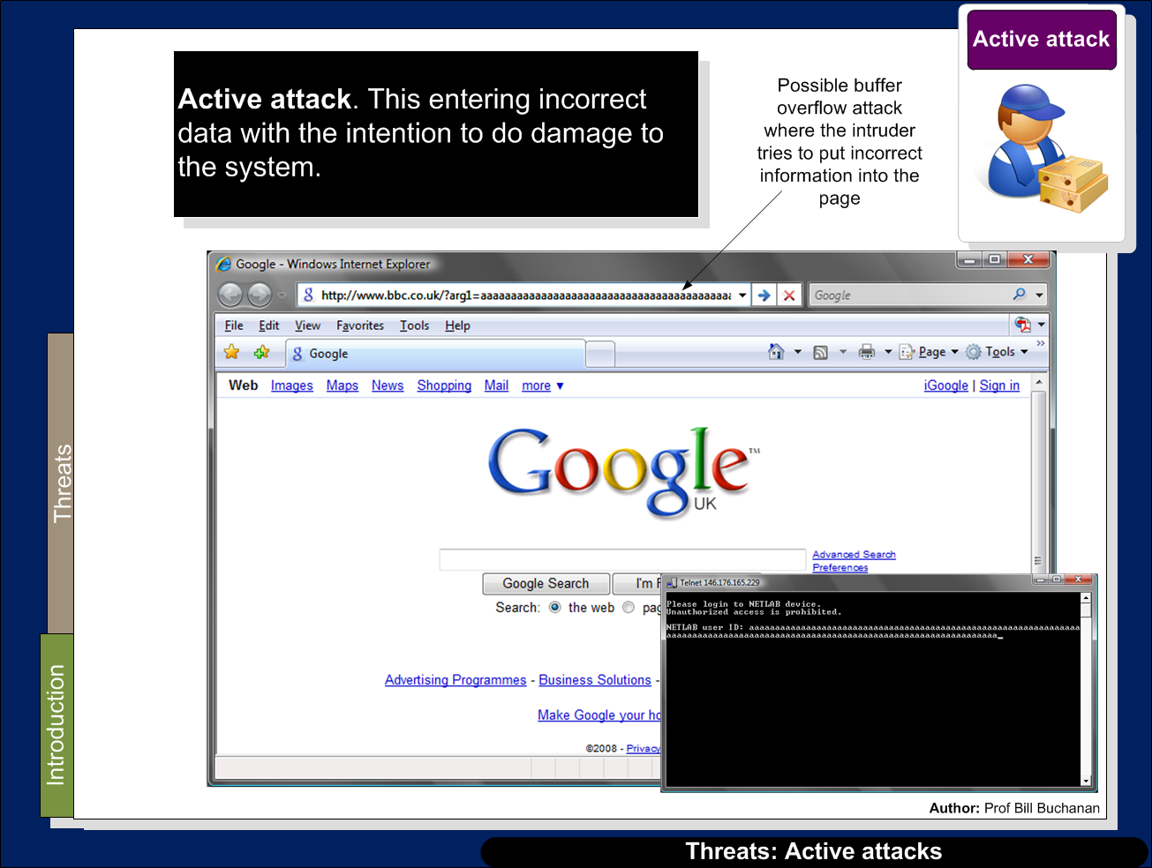

Slide 34
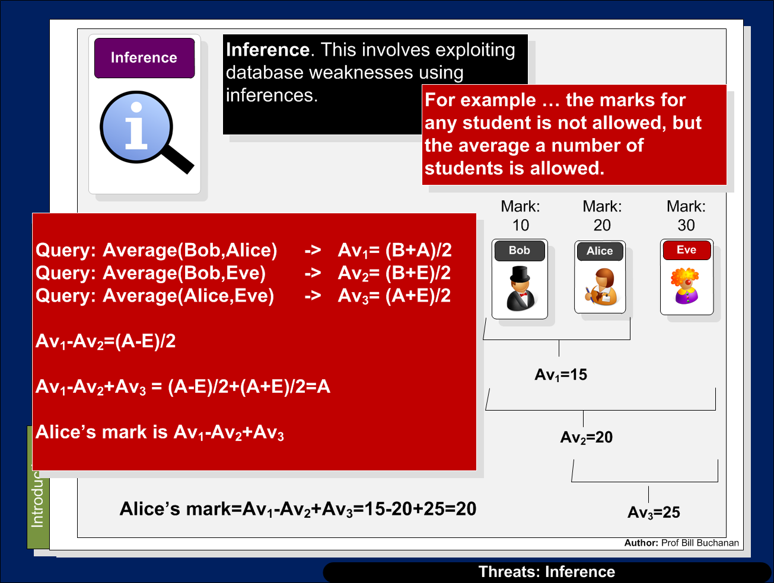

Slide 35
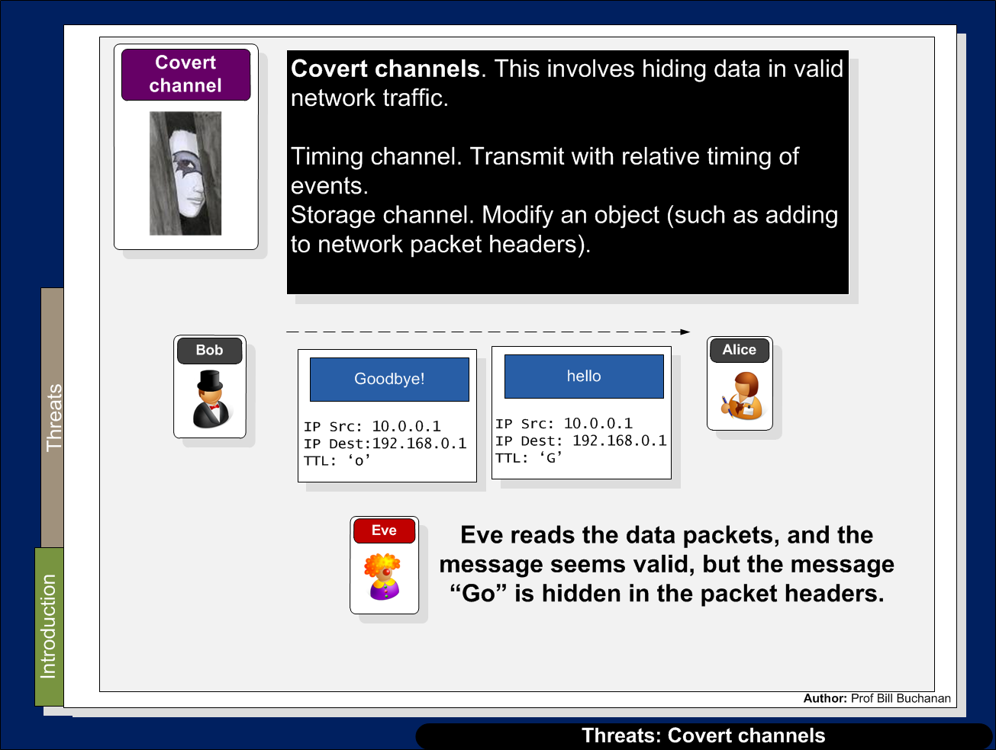

Slide 36
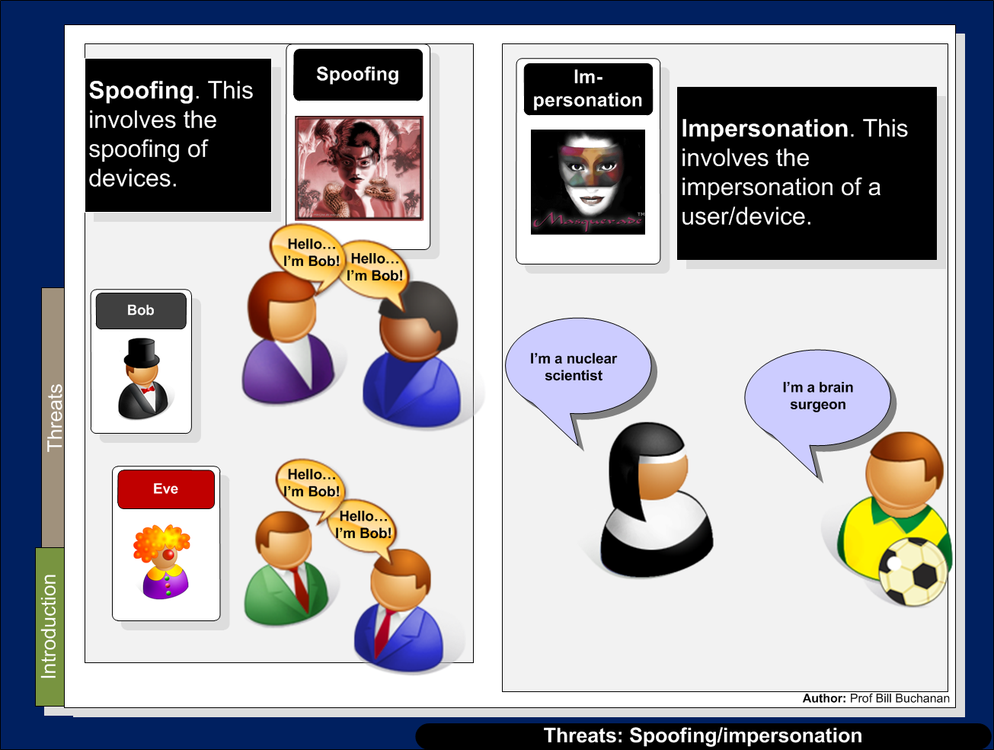

Slide 37
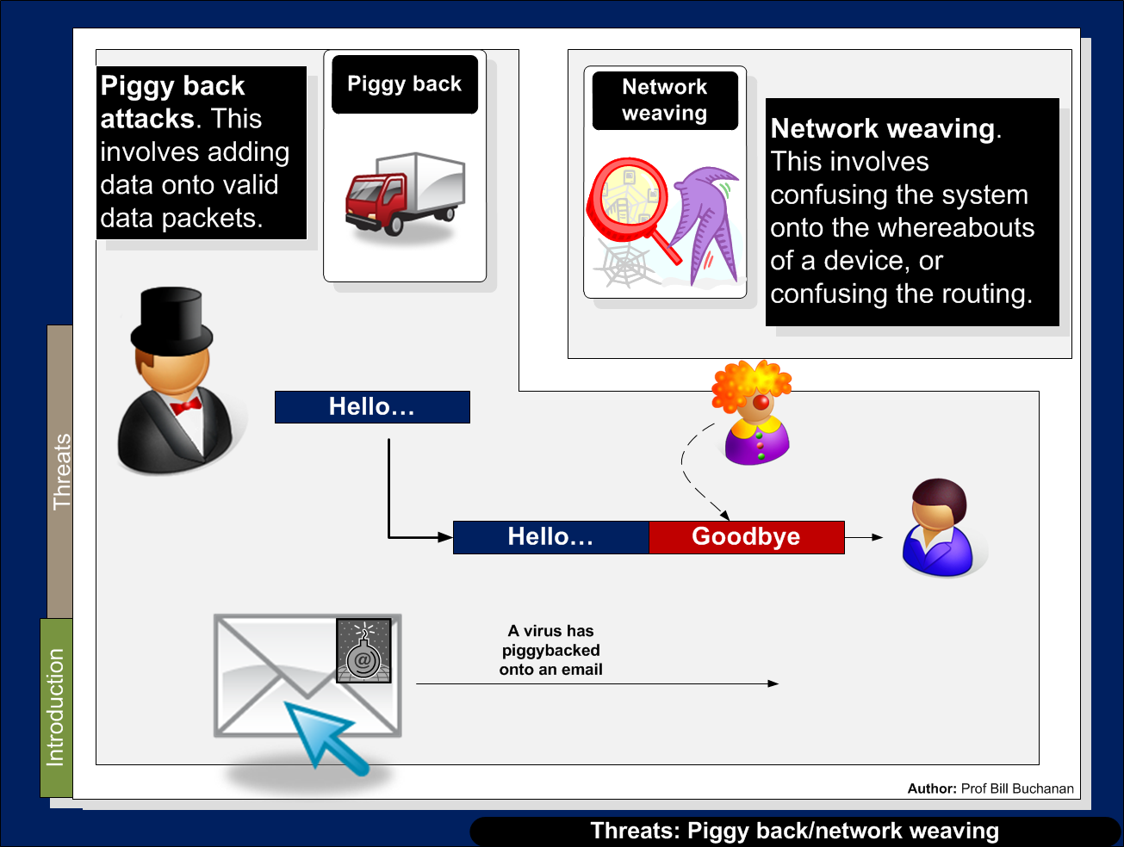

Slide 38
